Slide 1
Clojure in 10 Minutes
Clojure Meet-Up Copenhagen
September 23, 2010
Martin Jul, mj@ative.dk / @mjul

Slide 2
What is Clojure?
Lisp
Functional Programming
Immutable, persistent data structures
Software Transactional Memory
Object-oriented (sort of)
Macros
Managed code: JVM and CLR
Getting off the Lisp Island
Clojure is the future!
-- Uncle Bob

Slide 3
Syntax and Data Types
; This is a comment, semicolon is similar to // in C# / Java
;; List is the most common data structure
'(1 2 3)
;; Vector is a list that is indexable by position
[1 2 3]
;; Maps are associative data structures
{:key "value", :id 42}
;; Sets are mathematical sets
#{1 2 3}
;; Expressions are lists of form (function arg-1 arg-2 ...)
(println "Hello, World")
(+ 1 2 3)
List
Vector
Map
Set
Expression
file: core.clj

Slide 4
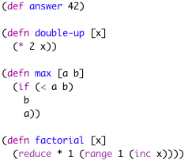

Clojure Basics
Incidentally this could also have been a modem connect string
file: functional.clj

Slide 5



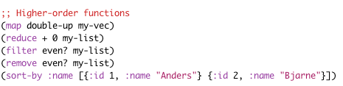
Functional Programming
file: functional.clj

Slide 6
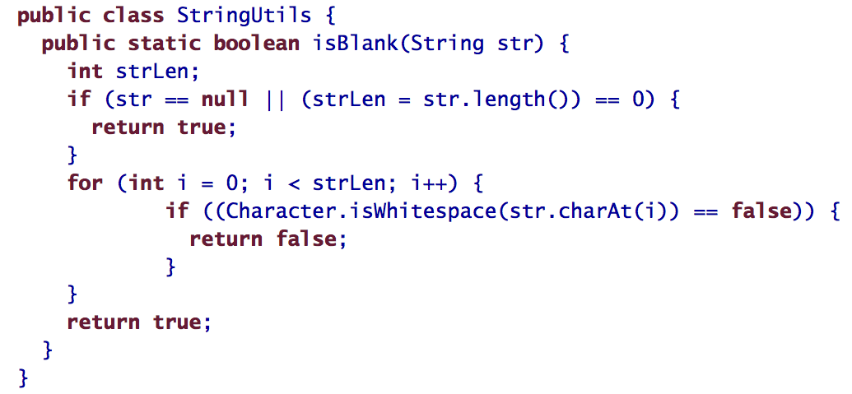
Simple and Concise
This makes my eyes hurt!
(defn blank? [s]
(every? #(Character/isWhitespace %) s))
Source: Programming Clojure by Stuart Halloway (Pragmatic Programmers, 2009)
Notes:
Cyclomatic complexity huge - Clojure version has no conditionals, no branches.

Slide 7
”State – you’re doing it wrong”
Immutable
Persistent (struktural sharing, not copying)
Simpler code
Less concurrency issues
b
(def a (list 1 2 3))
(def b (rest a))
a
1
2
3
e.g. stable enumerations

Slide 8
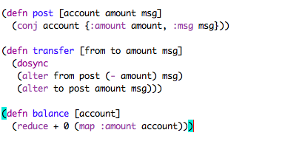
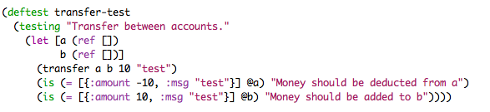
STM – Software Transactional Memory
concurrency-safe in-memory transactions!
1
ref
1
2
file: stm.clj

Slide 9
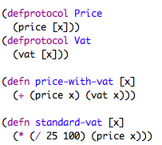



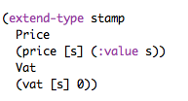
Object Oriented with Protocols
Open for extension, closed for modification
(price-with-vat espresso)
(vat iver)
file: oo.clj

Slide 10



Multi-methods
Open-Closed Principle goodness
Not your mother’s dispatch
file: multi.clj

Slide 11
The Clojure Compiler
Your hip friends call this language homoiconic
Text
Clojure data structures
(read stream)
Reader
AST
Macro evaluation
AST
Compiler
Great for DSLs
(eval ast)
Byte code
Compiler is available at runtime

Slide 12
Example: Compojure web app
shorter than your web.config!
(ns hello-world
(:use compojure.core, ring.adapter.jetty)
(:require [compojure.route :as route]))
(defroutes main-routes
(GET "/" [] "<h1>Hello World</h1>")
(route/not-found "<h1>Page not found</h1>"))
(run-jetty main-routes {:port 8080})
Source: http://github.com/weavejester/compojure

